Slide 1
Normalization
Course Code: CSC 2108
Course Title: Introduction to Database
Dept. of Computer Science
Faculty of Science and Technology
Lecturer No: | 14 | Week No: | 09 | Semester: | TBA
Lecturer: | Nazia Alfaz nazia.alfaz@aiub.edu

Slide 2
Lecture Outline
Introduction
The Normal Forms
Modification Anomalies
Real World Exercise

Slide 3
Why Normalize?..
Flexibility
  Structure supports many ways to look at the data
Data Integrity
  “Modification Anomalies”
    Deletion
    Insertion
    Update
Efficiency
  Eliminate redundant data and save space

Slide 4
Normalization
Normalization
A database design technique that reduces data redundancy and eliminates undesirable characteristics like Insertion, Update and Deletion Anomalies.
Divides larger tables into smaller tables and links them using relationships.
The purpose of Normalization in SQL is to eliminate redundant (repetitive) data and ensure data is stored logically.
Normal Form
A relation that results from applying simple rules regarding Functional Dependences (or relationship between attributes) to that relation.

Slide 5
Data Redundancy
Major aim of relational database design is to group attributes into relations to minimize data redundancy and reduce file storage space required by base relations.
Problems associated with data redundancy are illustrated by comparing the following Staff and Branch relations with the StaffBranch.

Slide 6
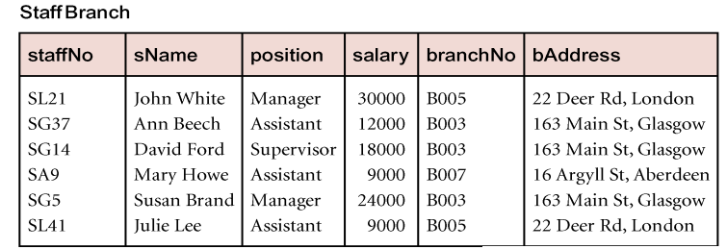
Data Redundancy

Slide 7
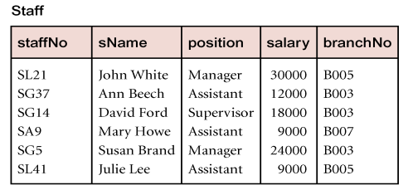
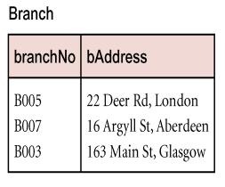
Data Redundancy
StaffBranch relation has redundant data: details of a branch are repeated for every member of staff.
In contrast, branch information appears only once for each branch in Branch relation and only branchNo is repeated in Staff relation, to represent where each member of staff works

Slide 8
Insertion Anomalies
New member of staff joins branch B005
● Insert new row into StaffBranch table
● Type wrong address: 163 Main St, Glasgow.
● Database is now inconsistent!
Establish new branch with no members of staff
● B008, 57 Princes St, Edinburgh
● No staff members, so staffNo must be NULL
● But staffNo is the primary key of the StaffBranch table, so
cannot be NULL!

Slide 9
Deletion Anomalies
Mary Howe, staffNo SA9, leaves the company
● Delete the appropriate row of StaffBranch
● This also deletes details of branch B007 where Mary Howe works
● But no-one else works at branch B007, so we no longer know the address of this branch!

Slide 10
Modification Anomalies
Branch B003 has transferred to a new location
● New address is 145 Main St, Glasgow
● Must change three rows of the StaffBranch relation

Slide 11
1st Normal Form
A relation in which intersection of each row and column contains one and only one value. Each column contains only one value and no duplicate rows are allowed. If no unique is present add a unique key (primary key)
Student-Report
Student ID | Student Name | Address | CGPA | Course ID | Course Title | Course Grade | Faculty Name | Faculty Designation | Faculty ID
10 | Timmy | 800/2, Gulshan | 3.48 | ENG101 FS05 | English-2 Physics-1 | A+ B | MR. Ron MS. Mira | Lecturer Assistant Professor | 333 555
20 | Rimmy | 60/A, Boshundhora | 3.60 | ENG101 CS230 CS210 | English-2 IDB C++ | A A- B+ | MR. Ron MS. Hasina MS. Hasina | Lecturer Lecturer Lecturer | 333 888 888

Slide 12
Application Of 1st Normal Form
Student-Report
Student ID | Student Name | Address | CGPA | Course ID | Course Title | Course Grade | Faculty Name | Faculty Designation | Faculty ID
10 | Timmy | 800/2, Gulshan | 3.48 | ENG101 | English-2 | A+ | MR. Ron | Lecturer | 333
10 | Timmy | 800/2, Gulshan | 3.48 | FS05 | Physics-1 | B | MS. Mira | Assistant Professor | 555
20 | Rimmy | 60/A, Boshundhora | 3.60 | ENG101 | English-2 | A | MR. Ron | Lecturer | 333
20 | Rimmy | 60/A, Boshundhora | 3.60 | CS230 | IDB | A- | MS. Hasina | Lecturer | 888
20 | Rimmy | 60/A, Boshundhora | 3.60 | CS210 | C++ | B+ | MS. Hasina | Lecturer | 888

Slide 13
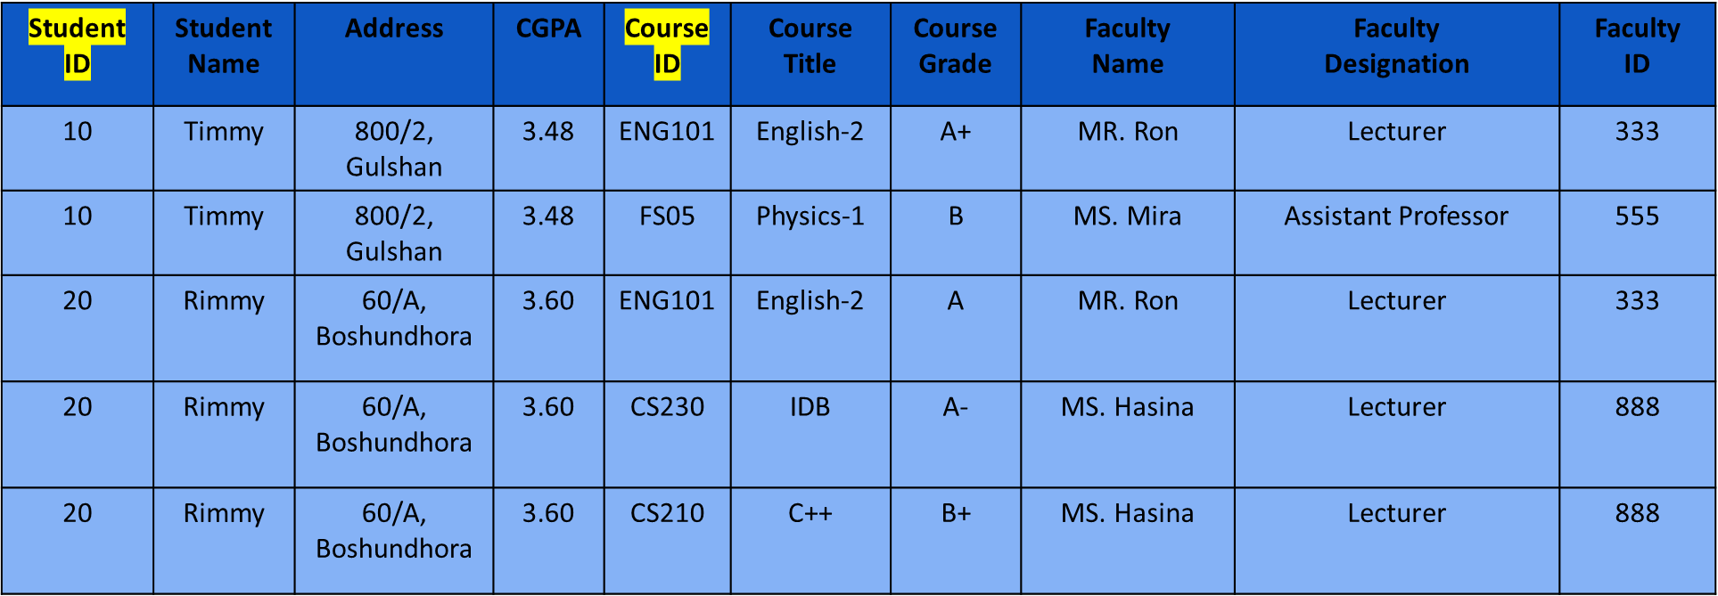
Anomalies in 1st Normal Form
Composite Key(Student ID, Course ID)
Insertion Anomaly:
If A new course is introduced and no students are registered in that course the student ID will be NULL and primary key can’t be NULL.
Deletion Anomaly:
If timmy leave the university, we can not make the student ID NULL. Moreover, the course details of Physics-1 and details of MS. Mira will be lost.
Updation Anomaly:
To change the address of student Rimmy, we need to change three rows from the table. Which can occur data redundancy, data inconsistency and extra space consumption issue.

Slide 14
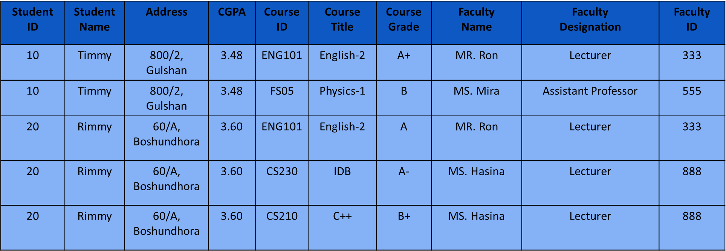
2nd Normal Form
A relation will be in 2NF if,
The relation is already in 1NF
The non-key attributes dependent on the primary key

Slide 15
2nd Normal Form
There are 3 functional dependency in the Student-Report relation-
Student ID,Student Name, Address, CGPA
Course ID, Course Title, Faculty Name, Faculty ID, Faculty Designation
Student ID, Course ID, Course Grade

Slide 16
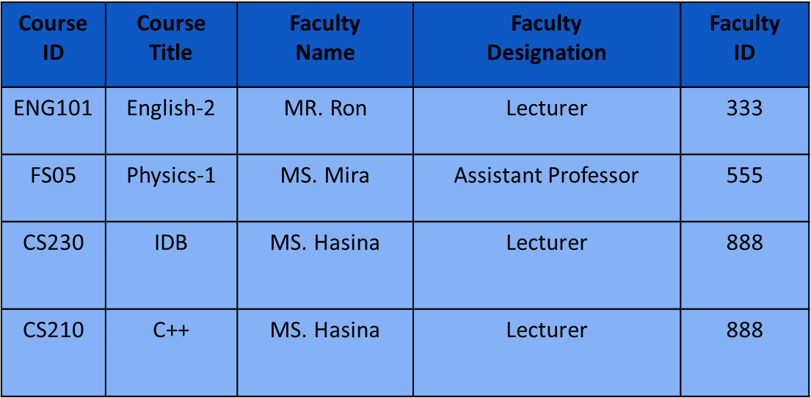
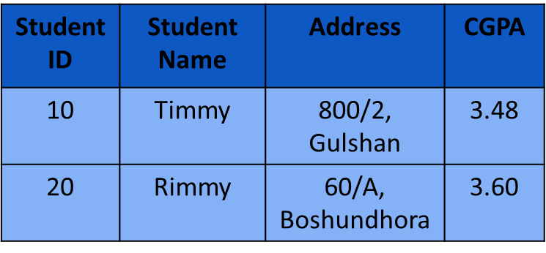
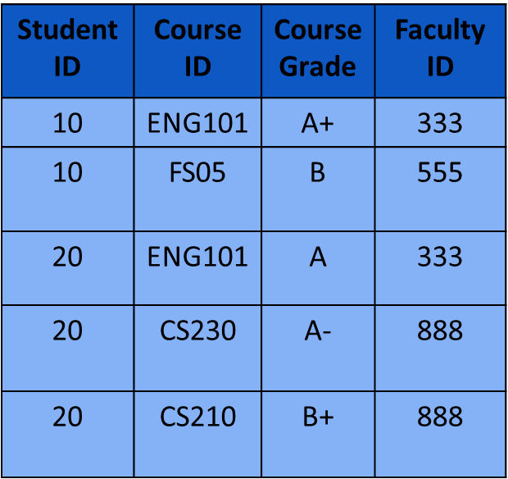
Application of 2nd Normal Form
Course-Faculty
Student
Grade

Slide 17
3rd Normal Form
A relation will be in 3rd normal for if
It is already in 2nd normal form
If there is no transitive dependency in the relation. All the columns can be determined by only the key column not by any other column. A functional dependency is said to be transitive if it is indirectly formed by two functional dependencies.
Course-Faculty

Slide 18
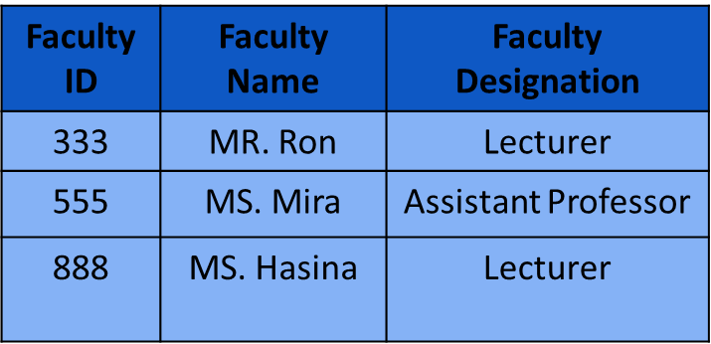
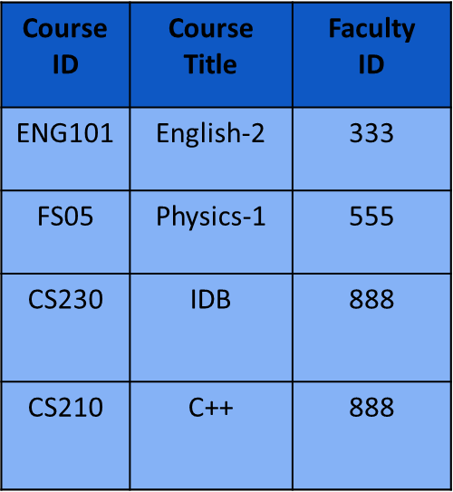
Application of 3rd Normal Form
Student
Faculty
Course
Grade

Slide 19
Books
Modern Database Management (Sixth Edition) by Fred R. McFadden, Jeffrey A. Hoffer, Mary B. Prescott
Database System Concepts (Fifth Edition) by Henry F. Korth, S. Sudarshan, A. Silberschatz
Oracle-database-10g-sql-fundamentals-1-student-guide-volume-1
SQL and Relational Theory: How to Write Accurate SQL Code by C.J. Date
Database Systems: A Practical Approach to Design, Implementation and Management (4th Edition) by Thomas M. Connolly, Carolyn E. Begg
Fundamentals of Database Systems, 5th Edition by RamezElmasri, Shamkant B. Navathe
Database Design and Relational Theory: Normal Forms and All That Jazz by C. J. Date
An Introduction to Database Systems 8th Edition, by C.J. Date

Slide 20
References
https://www.db-book.com/db6/slide-dir/index.html
https://docs.oracle.com/en/database/oracle/oracle-database/20/sqlrf/SQL-Standards.html#GUID-BCCCFF75-D2A4-43AD-8CAF-C3C97D92AC63
https://www.slideshare.net/HaaMeemMohiyuddin1/data-knowledge-and-information
https://www.tutorialspoint.com/index.htm
https://www.slideshare.net/tabinhasan/from-data-to-wisdom
https://www.slideshare.net/thinnaphat.bo/

